Slide 1
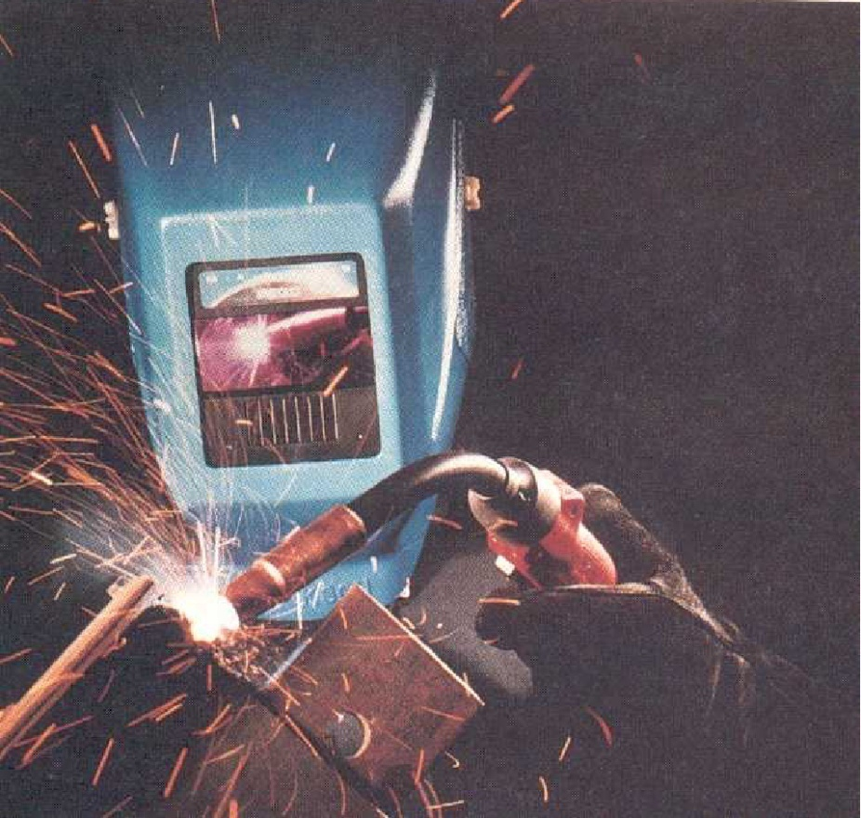
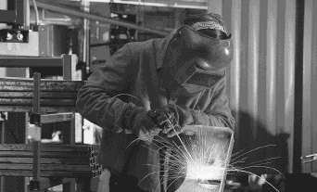
Welding, Soldering & Brazing

Slide 2
Welding
Defined as the metallurgical joining of two metal
pieces together to produce essentially a single
piece of metal.
Uses: Fabrication work - metal plates, rolled steel sections - castings of ferrous metals are joined together Repairing broken metal parts

Slide 3
Classification
WELDING
PRESSURE WELDING
FUSION WELDING
FORGE WELDING
RESISTANCE
WELDING
THERMITWELDING
ARC WELDING
GAS WELDING
SPOT WELDING
BUTT WELDING
SEAM WELDING
PERCUSSION WELDING
METAL ARC
ATOMIC HYDROGEN
CARBON ARC

Slide 4
Pressure welding | Fusion Welding
Parts to be joined are heated to plastic state then joined together
by applying external pressure
Parts to be joined are heated to the molten state and allowed to
solidify
Forge welding
Resistance welding
Arc welding
Gas welding
Non pressure welding

Slide 5
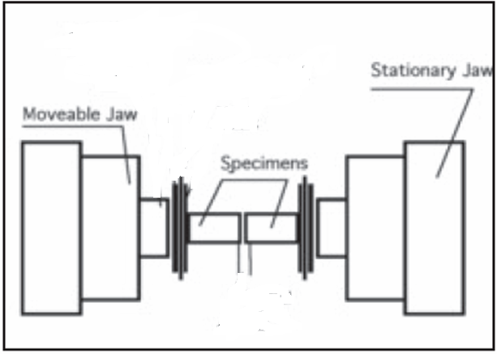
Resistance welding
Stationary Jaw
Movable Jaw
Metal parts
Welding gun

Slide 7
Resistance welding
- Uses the principle of both the pressure & fusion welding
PRINCIPLE
- Consists of heating of the parts to be welded to the plastic
state and joined together by applying the mechanical pressure
- Parts are heated by passing a heavy electric current
- Current encounters very high resistance at the joints, as
a result temperature increases
- When temperature exceeds melting temperature of the
parts external mechanical pressure is applied
- Joining thin metal sheets and wires

Slide 8
Advantages:
Little pollution
Efficient energy use
High production rates
Disadvantages:
Used for joining relatively thin materials
Equipment is costly

Slide 9
Principle of Electric Arc welding
Electrode holder
Power source
(AC / DC)
Cables
Electrode
Clamp
Arc
Workpiece
Figure : Principle of Arc welding

Slide 10
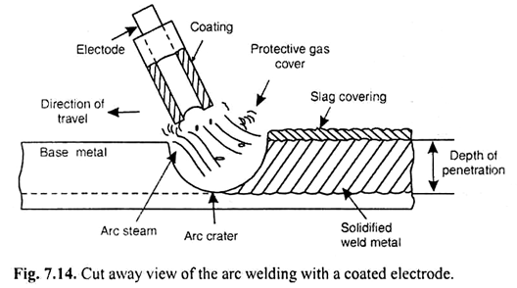

Slide 11
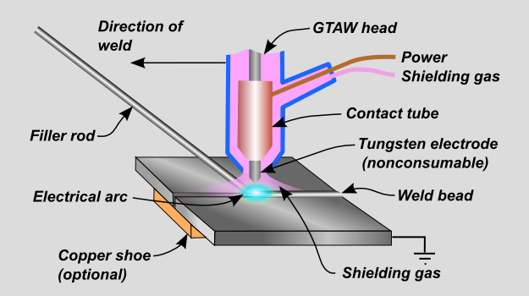

Slide 12
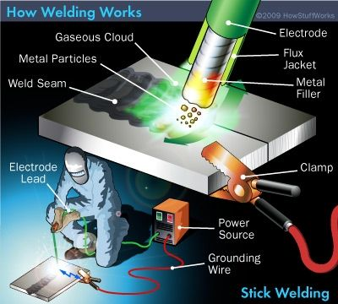

Slide 13
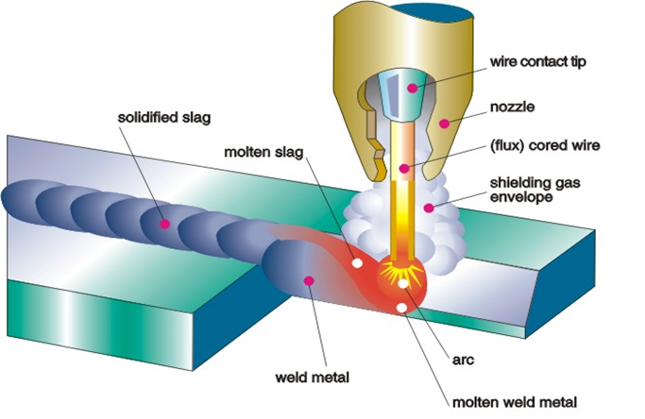

Slide 14
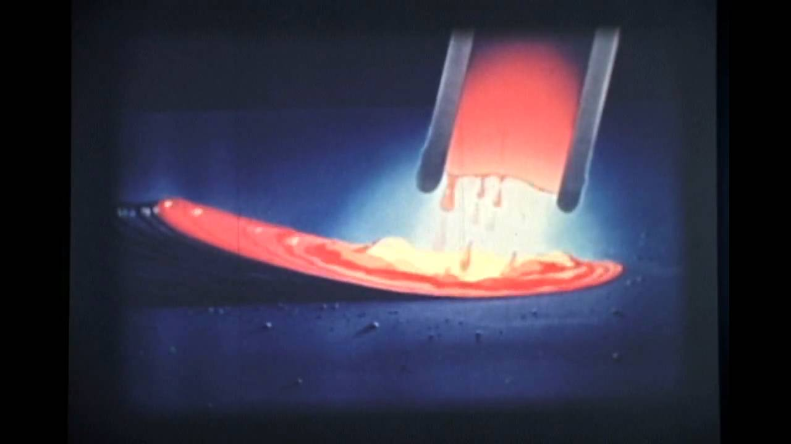

Slide 15
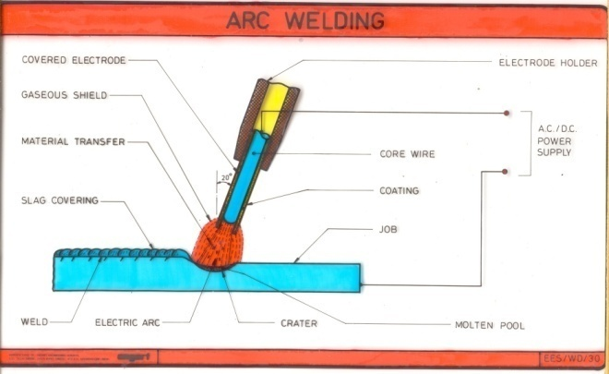
Slag
Plates before welding
Welded joint
Principle:
Plates to be welded will act as one pole of the electric circuit
Electrode held by the operator forms the other pole
When electrode comes in contact with the plates arc is formed
Intense heat melts the edges of 2 plates & creates a molten
metal pool
Electrode tip neat the arc also melts & enters the pool
Strong joint is formed when molten metal cools & solidifies

Slide 16
Types of welding electrodes
WELDING ELECTRODES
Consumable electrodes
Non-consumable electrodes
Bare
Coated
Consumable electrodes
Melts along with the workpieces and fills the joint.
Non-consumable electrodes
Requires additional filler material
Advantage:
Amount of the metal deposited by the filler rod can be controlled

Slide 17
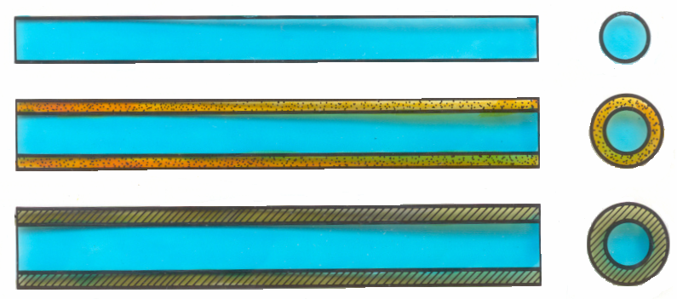
Coated and non-coated electrodes
a
b
1) Bare 2) Lightly coated 3) Coated a) FLUX b) WIRE

Slide 18
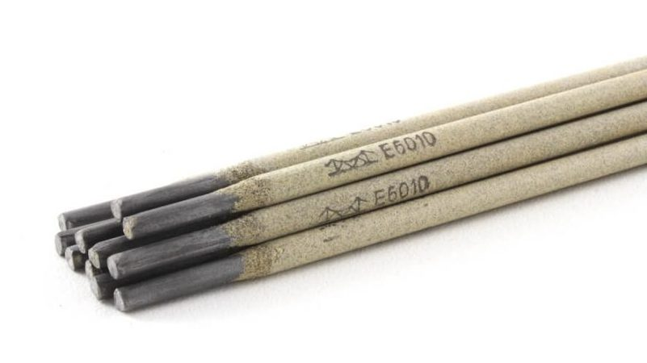
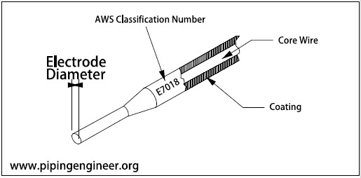

Slide 19
Functions of a coated electrode
- Protection of molten metal from oxygen and nitrogen of
the air by providing a gas shield around the arc and
the molten pool of metal
- Establish and maintain the arc throughout welding
- formation of slag over the joint thus protects from rapid
cooling
Limitation of a bare electrode
- Reduces the strength of the joint
- Non metallic constituents gets trapped in the solidifying
Weld metal

Slide 20
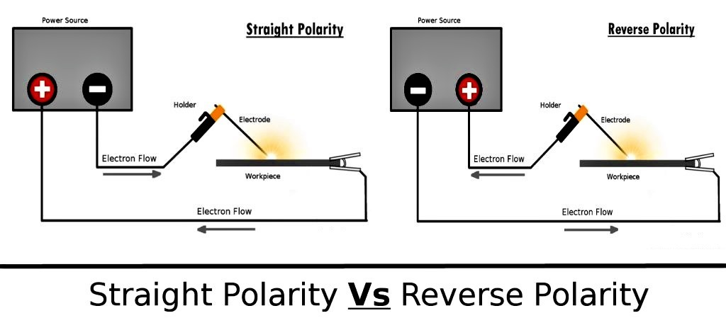

Slide 21
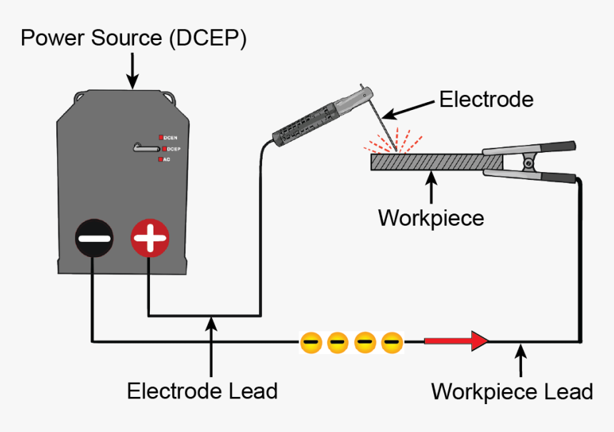

Slide 22
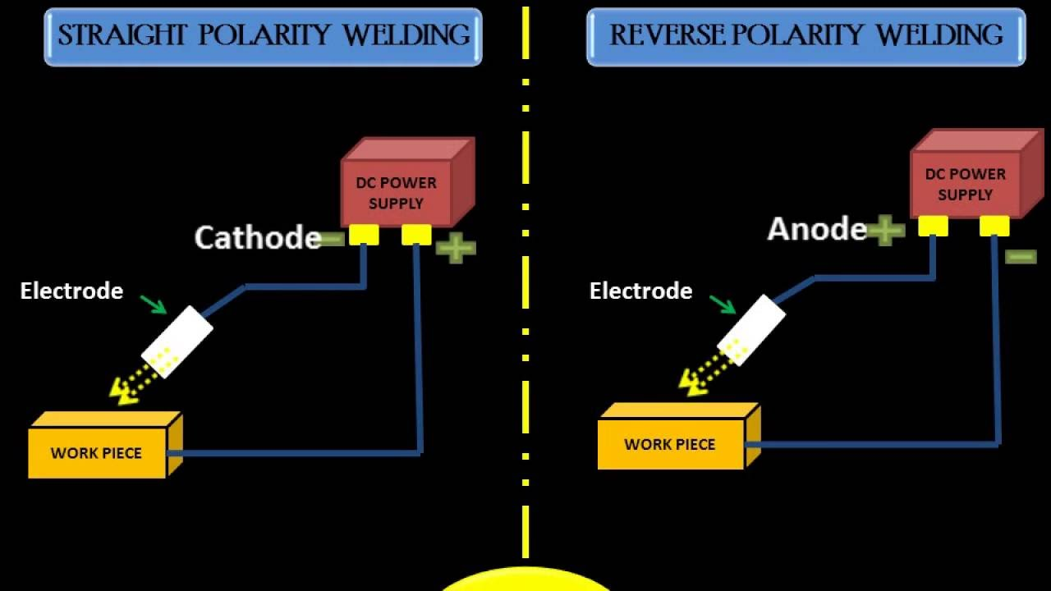

Slide 23
GAS WELDING

Slide 24
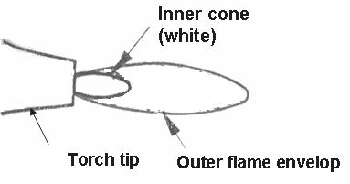
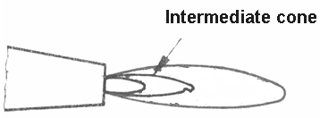
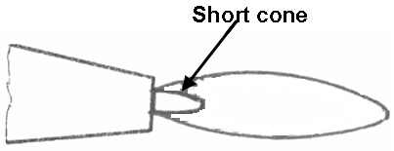
Gas welding flames
Neutral flame
Carburizing flame
Oxidizing flame

Slide 25
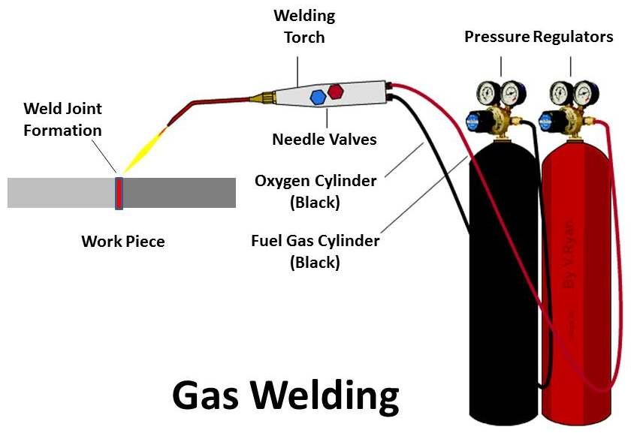

Slide 26
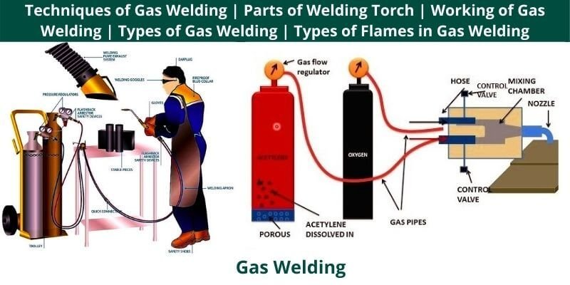

Slide 27
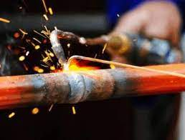
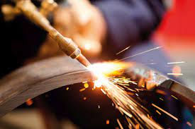
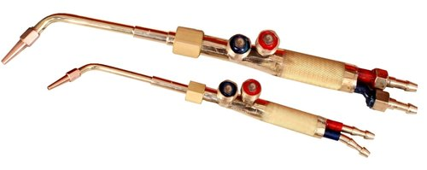

Slide 28
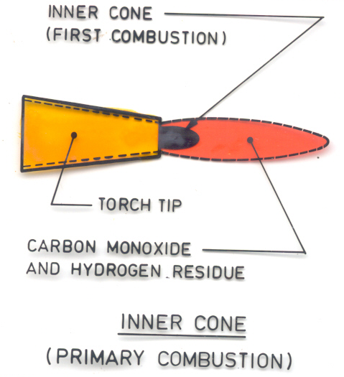
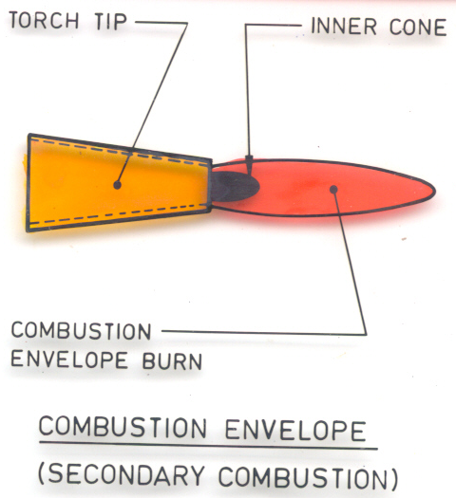
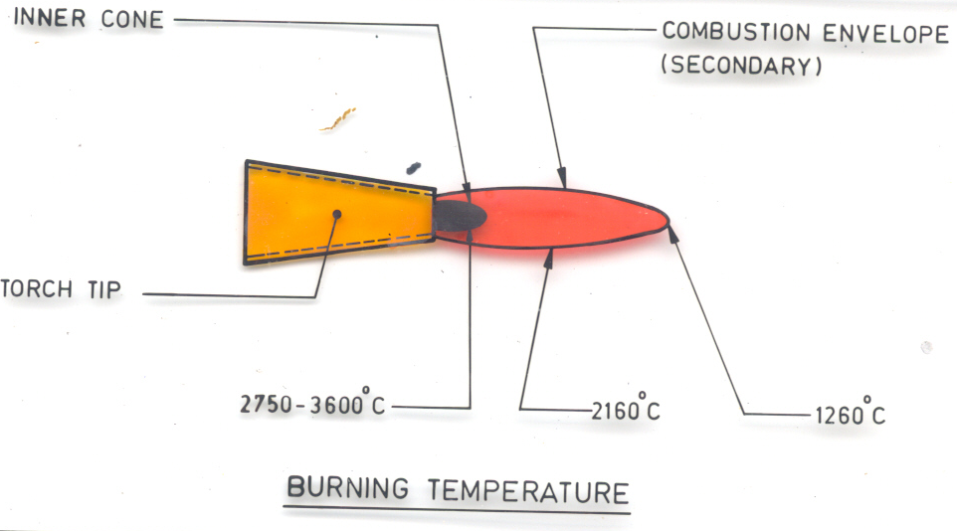
Gas welding flames

Slide 29

Gas Flames
Neutral flame
Obtained by supplying equal volumes of oxygen & acetylene
Used in oxy-acetylene welding
Carburizing flame
Obtained by supplying excess acetylene in the gas ratio 0.95 to 1
Consists of 2 cones
used in welding of alloy steels, cast iron & aluminium
Oxidizing flame
Obtained by supplying excess oxygen in the gas ratio 1.15 to 1.5
Inner white cone is shorter
Not suitable for welding

Slide 30
Oxy-Acetylene gas welding
Welding rod
Direction of welding
Torch Tip
Molten weld metal
Inner cone
Solidified weld metal
Base metal

Slide 31
Principle:
Fusion method of welding
Strong gas flame is used to raise the temperature of the
work pieces to melt their edges
Filler metal is used to fill the joint
Oxygen – Acetylene mixture is most commonly used
in gas welding

Slide 32
SOLDERING & BRAZING
Filler metal: brass or solder
Base metal
Characteristics of a brazed or soldered joint

Slide 33
SOLDERING
A method of uniting two thin metal pieces using a
dissimilar metal or an alloy by the application of heat
BRAZING
A method of joining two similar or dissimilar metals using a special fusible alloy

Slide 34
SOLDERING
Soft solder
Alloy of lead and tin
Melting temperature, 150 – 350⁰C
Hard solder
Alloy of copper , tin and silver
Soldering temperature, 600 – 900⁰C
Used for stronger joints
Flux
Clean the joint surfaces & to prevent oxidation
Zinc Chloride

Slide 35
Distinguish between brazing and soldering
Brazing | Soldering
Melting point of the filler material is above 450⁰C
Melting point of the filler material is below 450⁰C
Dissimilar metals can be joined easily
Only similar metals can be joined
Does not yield a good surface finish
Good surface finish
Stronger joints
Less stronger joints

Slide 36
Comparison of Soldering, brazing and welding
Soldering, Brazing | Welding
No direct melting of the base metals being joined
Direct melting of the base metals being joined
Useful for joining similar & dissimilar metals
Useful for joining similar metals
Brazing alloy and the solder have low melting points than the metals to be joined
Welding alloy has high melting point than the metals to be joined
Filler materials are solder and brazing alloy
Welding rod is used as filler material

Slide 37
WELD DEFECTS
Cracking
Due to incorrect electrodes / wrong procedure
Remedy: Re-welding
Incorrect Edge preparation
Too Narrow angle between edges result in weak weld
Tool wide angle between edges results in overheating
Craters
Concave depressions in the external surface of the joint
Under-cutting
Excess melting of parent metal which reduces its strength
Porous weld
Insufficient gap between electrode & workpiece results in poor penetration
Over welding

Slide 38
WELD DEFECTS
Cracking
Due to incorrect electrodes / wrong procedure
Remedy: Re-welding
Incorrect Edge preparation
Too Narrow angle between edges result in weak weld
Tool wide angle between edges results in overheating
Craters
Concave depressions in the external surface of the joint
Under-cutting
Excess melting of parent metal which reduces its strength
Porous weld
Insufficient gap between electrode & workpiece results in poor penetration
Over welding
Welding carried over an already welded layer
Results in over heating the earlier layer

Slide 39
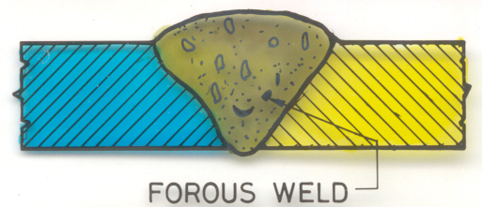
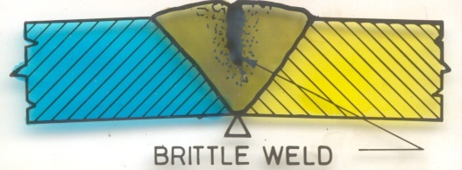
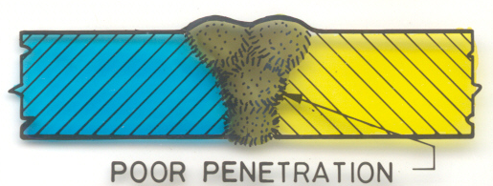

Slide 40
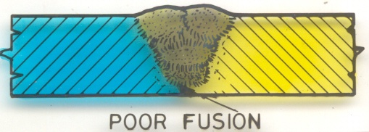
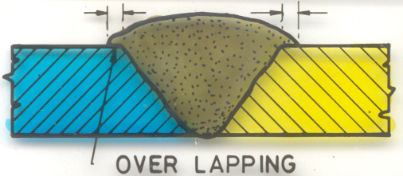
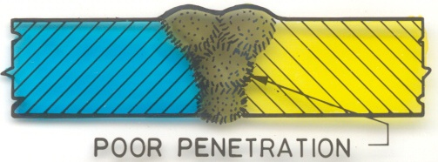

Slide 41
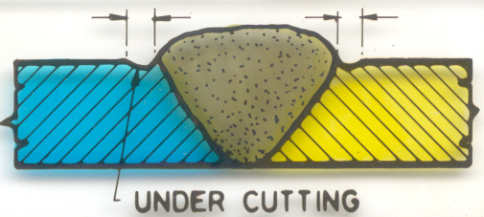
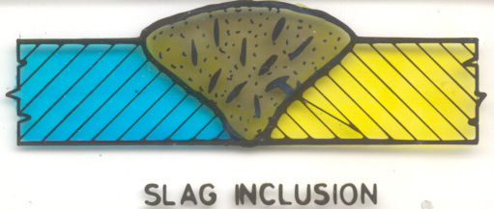
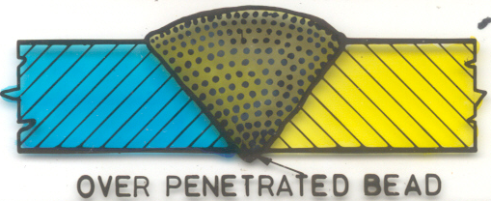

Slide 42
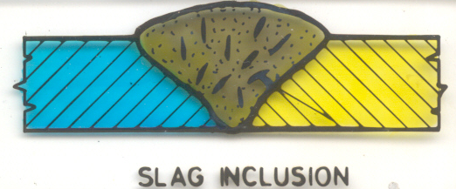
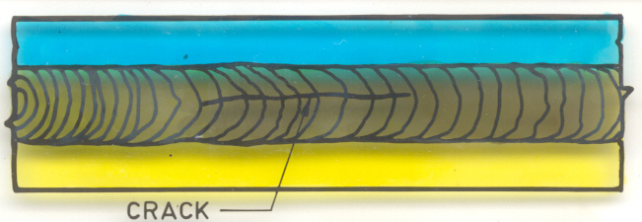
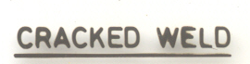
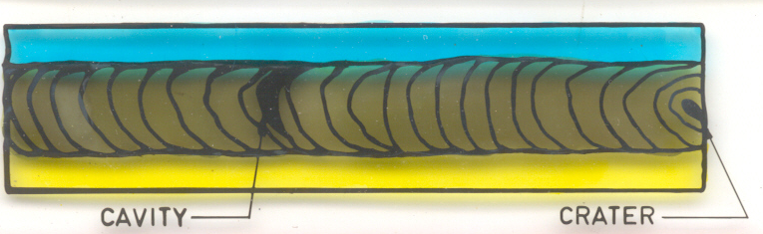
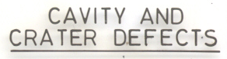

Slide 43
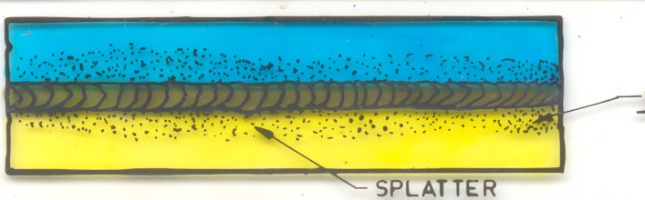


Slide 44
Joint types
Butt
Tee
Edge
Lap
Corner

